Slide 1

ConnectWise RMM Admin Program Kick-Off

Slide 2
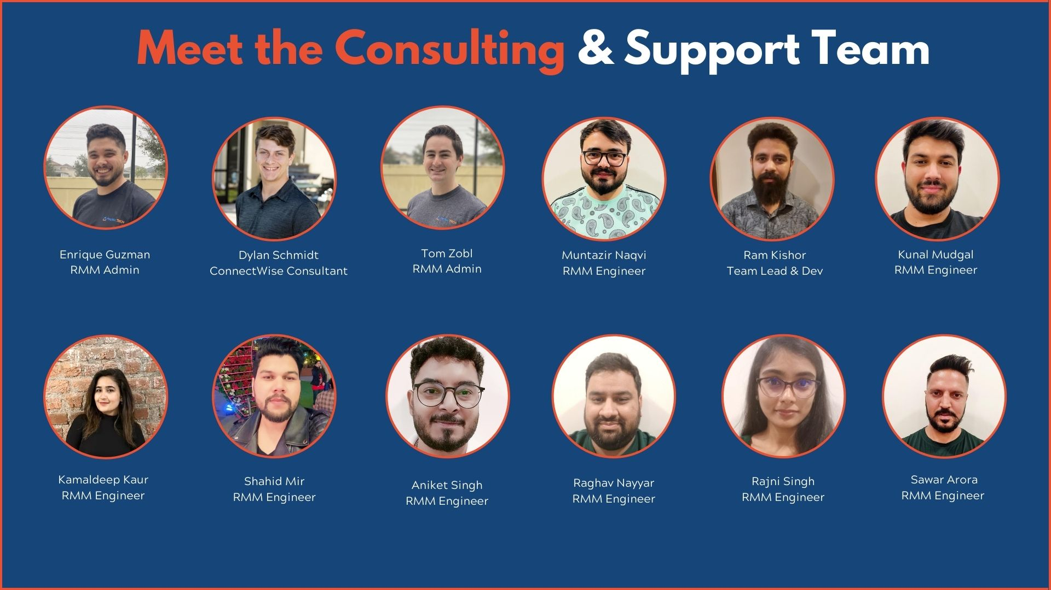
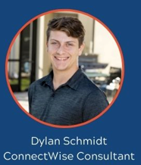


Chase Murphy Senior Consultant

Slide 3
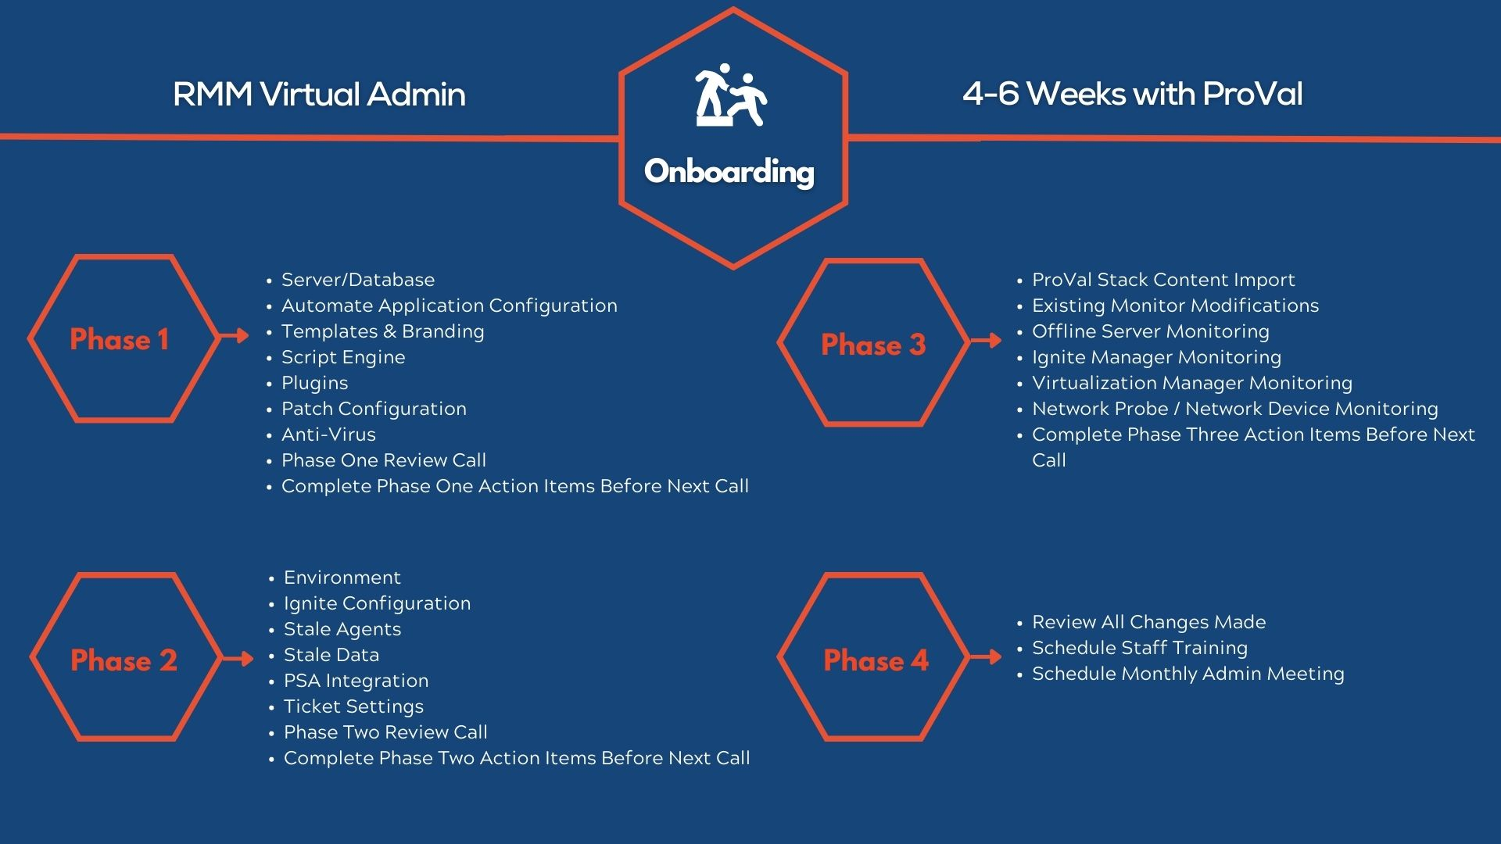
Package/Policy & Branding Review
Scheduled Script Review
Integrations Review
Patch Configuration Review
User Accounts Review
Brightgauge Patching Dashboard Creation
Week 1 Review call
Complete Action Items from Week 2 Call
Intellimon Monitoring Review & Suspension
Custom Monitor Review
Offline Server Monitoring
Custom ProVal Solutions Load-in
Week 3 Review Call
Complete Action Items from Week 1 Call
Antivirus Review
Sites Review
Environment Cleanup
Machine Groups
Agents Not Checking in Report and Cleanup
PSA and Ticket Review
Noise analysis
PSA Integration
CW Control Review
Week 2 Review call
Finish all action items
Schedule training (if desired)
Schedule Monthly Admin Call
Final Review Call

Slide 4
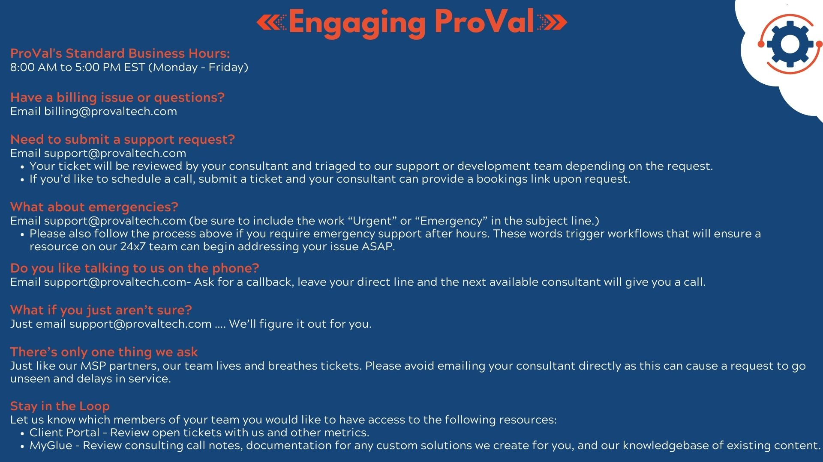

Slide 5
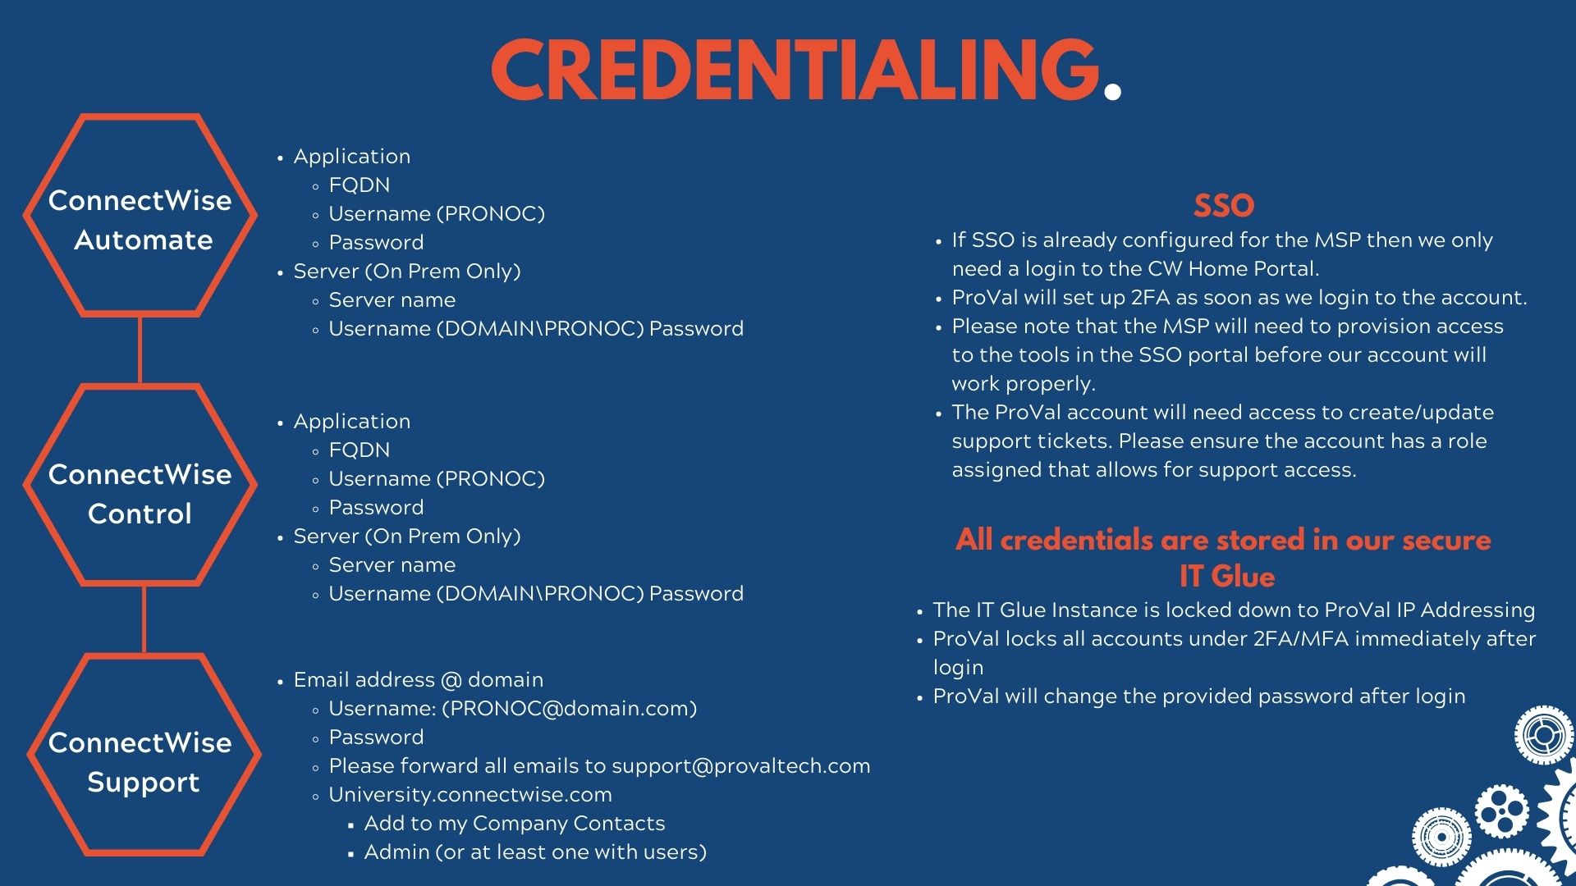
Application/SSO
Email: PRONOC@yourdomain.com
Password
Role: Super Admin
IP Restriction Management (if required)
Or if not SSO
Username
Password
Role: Super Admin
RMM/SSO

Slide 6
